Slide 1
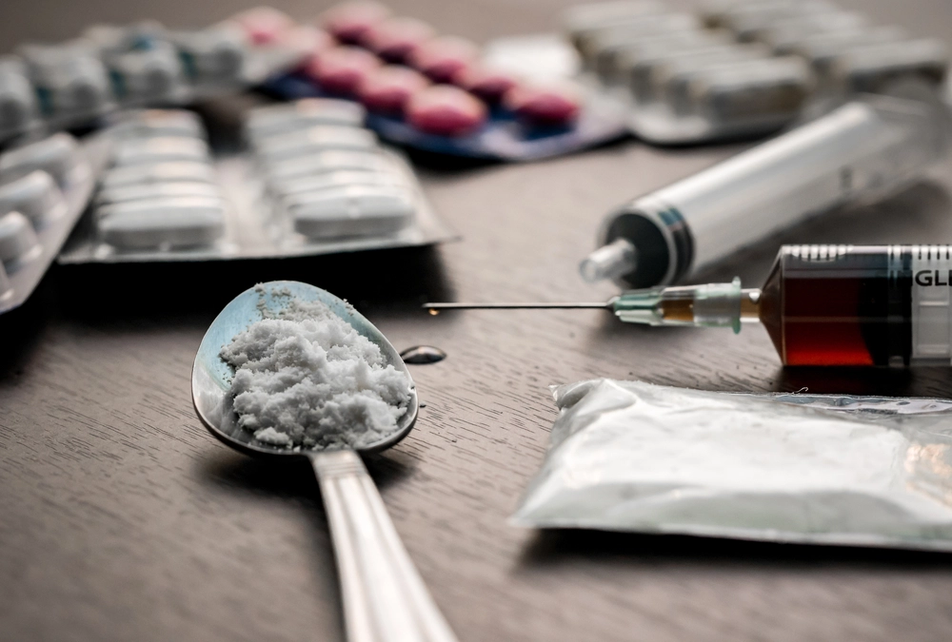

Drug and Substance Abuse in Nigeria
16th June, 2025

Slide 2
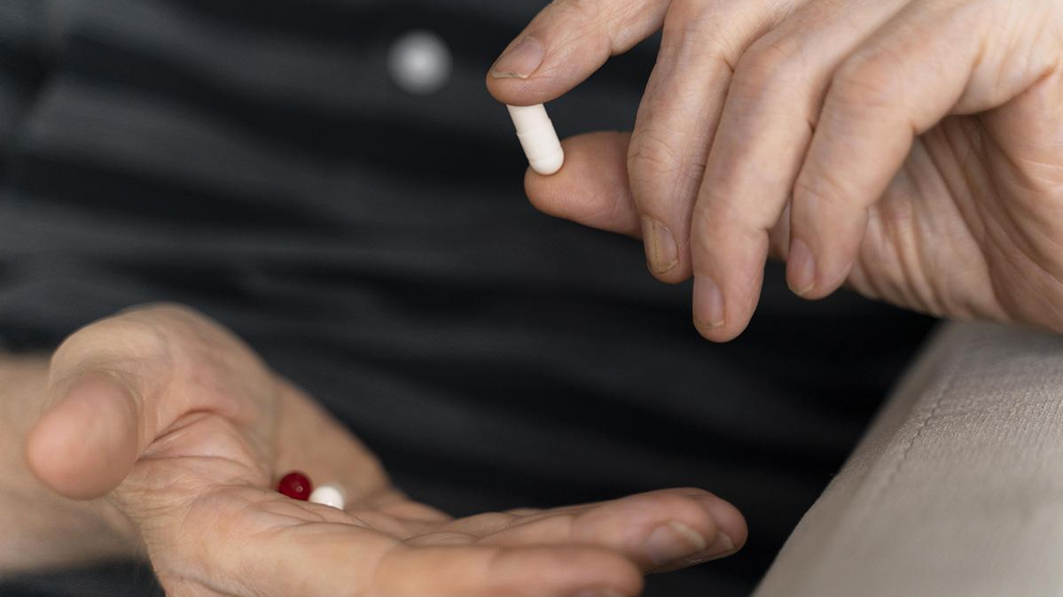
Background
Drugs refer to substances that alter the normal functioning of the body and mind. They can be legal (e.g., prescription medications) or illegal (e.g., cannabis, cocaine).
A medication is a drug specifically formulated, prescribed, and regulated for the treatment or prevention of diseases.
These substances (drugs) include a wide range of chemicals, both natural and synthetic, that can affect mental and physical health.
Many of these substances play a vital role in the treatment of medical conditions and are commonly found in various pharmaceutical products.
Drug abuse refers to the improper or non-medical use of these substances—this includes taking them without a valid prescription, using them for recreational purposes, or consuming them in excessive or unsafe quantities.

Slide 3
Background
Drug use is a significant global public health crisis, contributing to over 600,000 deaths annually, according to the World Health Organization (WHO, 2019). Combined global deaths from alcohol and psychoactive drugs account for about 3 million death annually.
275 million people globally used drugs in the past year (UNODC, 2022).
Global economic impact of drug abuse is estimated at $1 trillion annually due to lost productivity and healthcare costs (UNODC, 2022).
Without strengthened global action, drug-related deaths are projected to increase by 11% by 2030, disproportionately affecting Africa and Asia due to youthful populations and insufficient treatment coverage (WHO, 2019).
Drug use significantly contributes to rising crime rates, particularly theft, violence, and gang-related activities, as individuals often engage in criminal behavior to sustain their addiction or as a direct consequence of drug trafficking and organized crime (UNODC, 2023).
Substance abuse is strongly linked to mental health disorders, including depression, anxiety, psychosis, and suicidal behavior; studies show that people with drug use disorders are twice as likely to experience co-occurring mental health conditions (WHO, 2022).

Slide 4
Objectives
01
02
04
03
To determine the extent of drug use across different States and Regions in Nigeria.
To determine drug use pattern among drug users.
To determine the health consequences of drug and Substance Use.
To determine the impact of drug use on crime rate.
To provide data driven recommendations to NDLEA, Ministry of Health, UNODC etc. on drug abuse mitigation strategies.
05

Slide 5




DATA ANALYSIS PROCESS AND TOOLS
Data collection Data Cleaning Data Preprocessing Data Visualization
Sources:
United Nations Office on Drugs and Crime (UNODC), National Bureau of Statistics (NBS)
Create New Tables from Multiple sheets and workbook of collected Data
Visualization of Key Insight from Dataset
Trimming, Cleaning, Data type Formatting, missing Values

Slide 6
Drug and Substance Categories
Cannabis
Opioids
Heroin
Illegal opioid derived from morphine; highly addictive and fast-acting ( e.g Brown sugar, H, Smack (usually injected or snorted).
A psychoactive plant drug (marijuana) that alters mood and perception (e.g. Marijuana, Weed, Indian Hemp, Igbo).
Pain-relieving drugs that can cause euphoria and are highly addictive (for example, Morphine, Fentanyl).
Pharmaceutical Opioids
Amphetamines
Prescription painkillers (e.g., tramadol, codeine, morphine) with addiction risk.
Tranquilizers/Sedatives
Stimulants that increase alertness and are often misused for energy or focus (e.g Speed, Uppers, Benzedrine).
Medications that slow brain activity; used for anxiety but misused for calming effects (e.g Diazepam (Valium), Alprazolam (Xanax), Lorazepam (Ativan).

Slide 7
Drug and Substance Types
Cocaine
Cough Syrups
Ecstasy (MDMA)
Medications for cough relief that can be abused for sedation or euphoria (e.g , Benylin with Codeine, Emzolyn, Corex-D, Dextromethorphan syrups (non-codeine).
A powerful stimulant from coca leaves, increasing energy and alertness (e.g Coke, Crack, Snow (white powder or rock form).
A synthetic stimulant with hallucinogenic effects; used recreationally e.g Molly, E, XTC (often used at parties/clubs).
Hallucinogens
Methamphetamine
Solvents/Inhalants
Drugs that cause hallucinations and distort perception (e.g., LSD(Acid), Psilocybin (Magic Mushrooms), PCP.
A highly addictive illegal stimulant, more potent than regular amphetamines e.g Crystal Meth, Ice, Glass, Mkpuru Mmiri (local slang in Nigeria).
Household chemicals inhaled for psychoactive effects, often toxic (e.g., glue, Petrol, Kerosene, Paint Thinners, Correction fluid (e.g., Tippex).

Slide 8
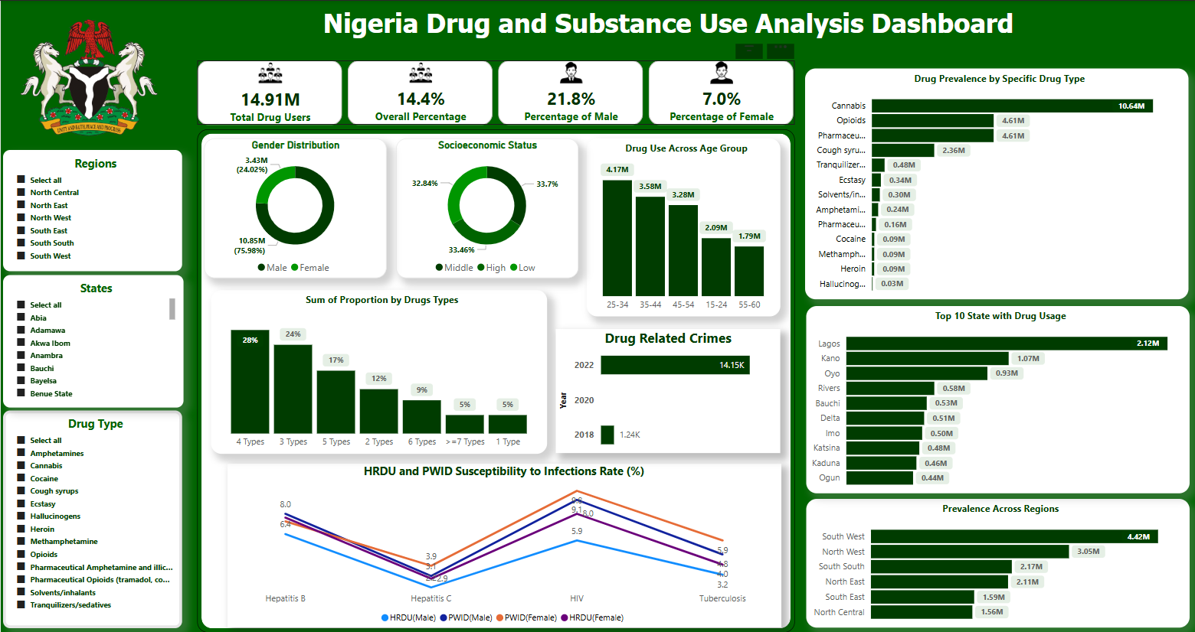

Slide 9
Key Insights
14.91 million Nigerians aged 15–64 are actively abusing drugs
Youths aged 25–34 are the largest user group.
Male usage dominates (73.8%), Females represent a significant minority (26.18%).
Poly-drug use is a fairly common phenomenon among
drug users in Nigeria both in the general population and among high-risk drug users. Nearly all (95%) of drug users use more than one substance either concurrently or sequentially.
The top 5 states with a high usage of drug and substance include; Lagos, Kano, Oyo, Rivers, and Bauchi respectively. Also, the South west records the highest number of drug Users.
There is a significant increase in the number of drug related crime in data available for 2022, which may suggest a corresponding increase in drug and substance use as seen in 2018 survey.
There is a heightened vulnerability among High-Risk Drug Users (HRDU) and People Who Inject Drugs (PWID) to infections such as HIV, Hepatitis B, Hepatitis C, and tuberculosis.
Cannabis ranks highest among the Drugs and Substance abused in Nigeria.

Slide 10
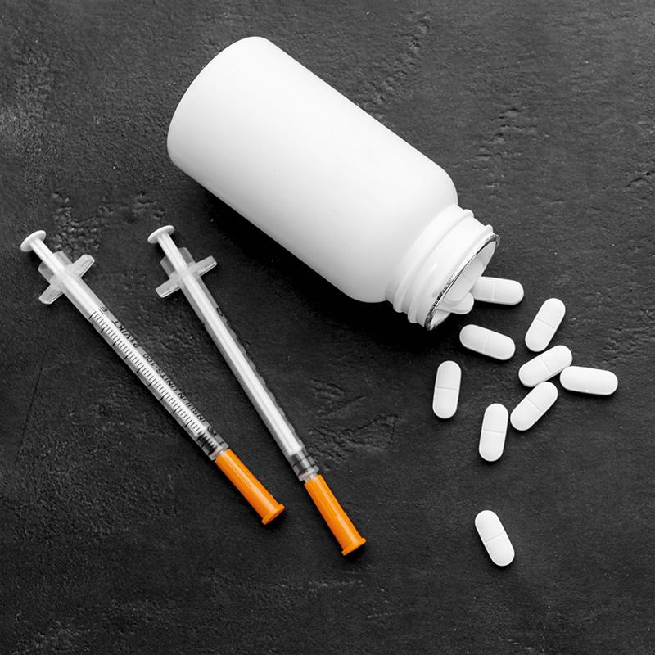
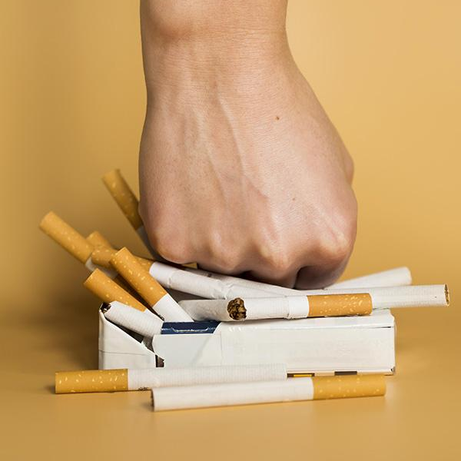
Recommendations
Despite the effort of agencies like the NDLEA, Nigeria still experience a significantly high prevalence, of drug and substance use across all regions.
1
Federal ministry of health, NDLEA, and other relevant Agencies should therefore consider the use of drug education both in formal institution (schools) and on the street (prison, motor parks etc.) such as community programs.
Greater investment and strategic focus should be directed toward curbing drug and substance abuse, particularly in Lagos, Kano, and Oyo States, where prevalence rates are among the highest nationally.
2
3
FGN and NDLEA should work on creating more rehabilitation Centers that can handle the level of drug and substance use prevalence in Nigeria, ensuring proper rehabilitation of all apprehended drug users and offenders, particularly in the south west Region.
4
Focus enforcement efforts on controlling access to Cannabis, Opioids, and Pharmaceuticals, Monitor and regulate pharmaceutical sales, especially tramadol and codeine-based cough syrups.
5
Partner with tech platforms to create drug abuse reporting hotlines and anonymous tips systems
6
NBS and other related agency should work on gathering more robust dataset on drug and substance use, that measures other indicators like mental health, economic effect, family background etc. in order to gain better insight into drugs use , causes, and effect.

Slide 11
Thank You

